Slide 1

Lower bounds
Divesh Aggarwal
School of Computing
Department of Computer Science

Slide 2
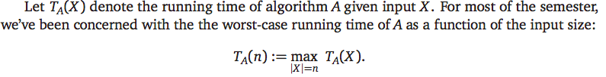

What is a lower bound?

Slide 3
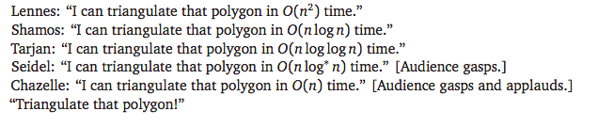
Upper bounds vs lower bounds
Algorithms research is often about statements like…

Slide 4
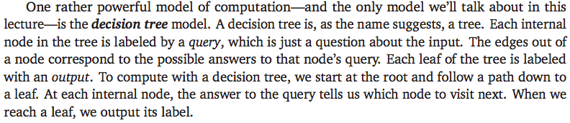
Decision tree model

Slide 5
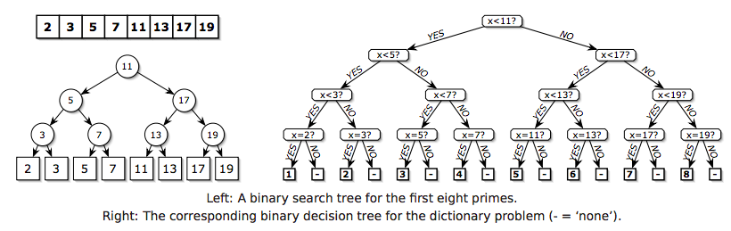
Decision tree for the dictionary problem..
Here’s another simple and familiar example, called the dictionary problem. Let A be a fixed sorted array with n numbers. Suppose we want to determine, given a number x, the position of x in the array A, if any.

Slide 6
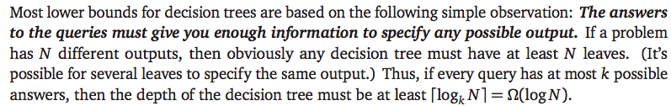

Decision tree for the dictionary problem..

Slide 7

The model is crucial..
No, it isn’t. The reason is that hashing involves a query with more than a constant number of outcomes, specifically ‘What is the hash value of x?’

Slide 8
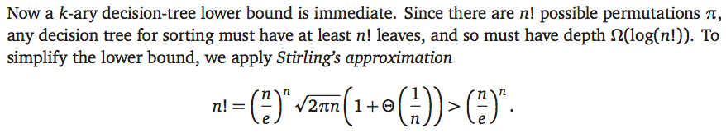
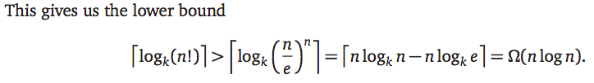
Sorting lower bound in the decision tree model

Slide 9
Finding the maximum
The information-theoretic method gives a lower bound of log n. This bound is tight. Why?
We can locate the maximum element by asking only log n ‘unreasonable’ questions like “Is the index of the maximum element odd?”
We need to consider a more reasonable model of computation, by restricting the kinds of questions the algorithm is allowed to ask. We will consider the comparison tree model, where every query must have the form “Is xi > x j?”.

Slide 10
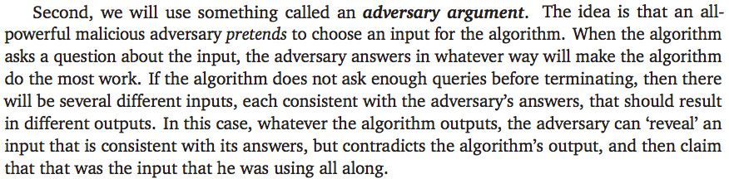
We will use the adversary argument
For the maximum problem, whenever the adversary reveals that x_{i} < x_{j} , he marks x_{i} as an item that the algorithm knows (or should know) is not the maximum element. If there are less than t comparisons, then the algorithm knows that t elements are not maximum. Any other element can be the maximum.
Thus, the algorithm is correct on all inputs if and only if t is at least n-1.

Slide 11
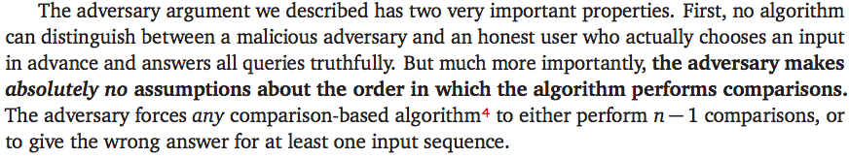
The adversary argument
You might want to look at the adversary arguments chapter from Jeff Erickson’s notes for other examples.

Slide 12
Linear sorting algorithms
Divesh Aggarwal
School of Computing
Department of Computer Science

Slide 13

Counting sort

Slide 14
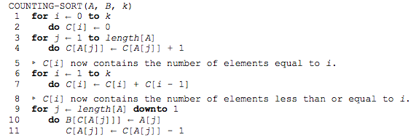

Counting sort

Slide 15
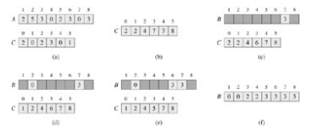

Counting sort

Slide 16

Radix sort
Intuitively, one might want to sort numbers based on their most
significant bit and then recursively sort based on the next
significant digit, etc.
However, this would require maintaining 10 different list of numbers (assuming numbers are in decimal notation)
Radix sort solves the problem of card sorting counterintuitively by sorting on the least significant digit first

Slide 17
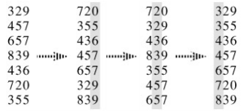
Radix sort
For d-digit numbers, we need d counting sort operations. The only requirement is that the counting sort algorithm is stable, i.e., equal elements’ doesn’t change while sorting.
The algorithm is straightforward and runs in time O(d(n+k))

Slide 18
Bucket sort
Bucket sort runs in linear time when the input is drawn from a uniform distribution. Like counting sort, bucket sort is fast because it assumes something about the input. Whereas counting sort assumes that the input consists of integers in a small range, bucket sort assumes that the input is generated by a random process that distributes elements uniformly over the interval [0, 1).
The idea of bucket sort is to divide the interval [0, 1) into n equal-sized subintervals, or buckets, and then distribute the n input numbers into the buckets. Since the inputs are uniformly distributed over [0, 1), we don't expect many numbers to fall into each bucket. To produce the output, we simply sort the numbers in each bucket and then go through the buckets in order, listing the elements in each.

Slide 19
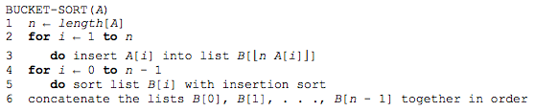
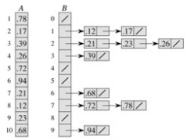
Bucket sort

Slide 20
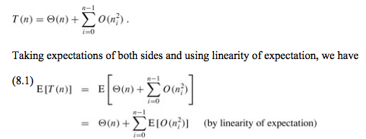

Bucket sort
E[n_{i}²] = 2 – 1/n (Exercise!)

Slide 21
Amortized analysis
Divesh Aggarwal
School of Computing
Department of Computer Science

Slide 22
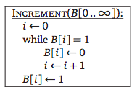
Incrementing a binary counter
The input B is an (infinite) array of bits, where B[i] = 1 if and only if 2^{i} appears in the sum.
If the first k bits are 1, and the next bit is 0, then INCREMENT takes time O(k)

Slide 23
Incrementing a binary counter
The input B is an (infinite) array of bits, where B[i] = 1 if and only if 2^{i} appears in the sum.
If the first k bits are 1, and the next bit is 0, then INCREMENT takes time O(k)

Slide 24
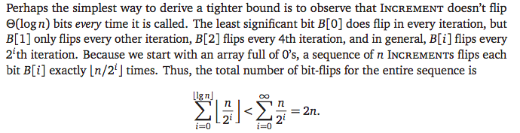
Counting from 0 to n
Now suppose we call Increment n times, starting with a zero counter. How long does it take to count from 0 to n? If we only use the worst-case running time for each Increment, we get an upper bound of O(n log n) on the total running time. Although this bound is correct, we can do better..

Slide 25
Amortized cost
This sense of “on average” is quite different from the averaging we consider with randomized algorithms. There is no probability involved; we are averaging over a sequence of operations, not the possible running times of a single operation. This averaging idea is called amortization—the amortized time for each Increment is O(1).

Slide 26
Taxation method
Instead of paying for each bit flip when it happens, the Increment Revenue Service charges a two-dollar increment tax whenever we want to set a bit from zero to one.
One of those dollars is spent changing the bit from zero to one; the other is stored away as credit until we need to reset the same bit to zero.
The key point here is that we always have enough credit saved up to pay for the next increment
The amortized cost of an Increment is the total tax it incurs, which is exactly 2 dollars, since each Increment changes just one bit from 0 to 1

Slide 27

Taxation method
See textbook for other variants of taxation/charging methods

Slide 28

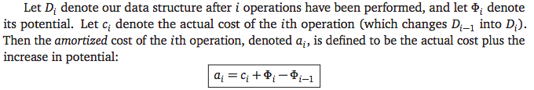
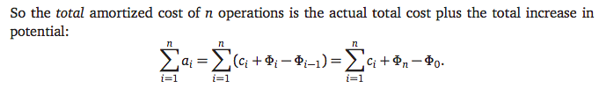
The potential method

Slide 29
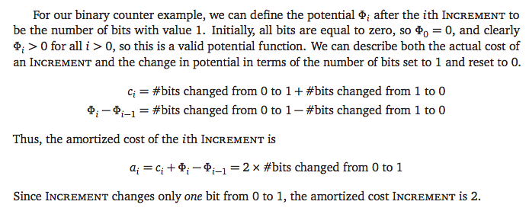
Binary counter example

Slide 30

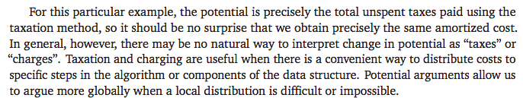
The potential method

Slide 31

Increment and decrement

Slide 32

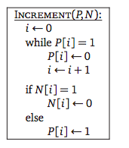
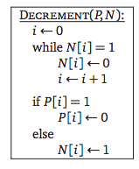
Increment and decrement

Slide 33

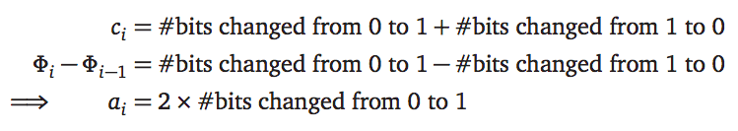
Increment and decrement

